Slide 1
Advanced Microelectronics Lab II ELCT 1001
amr.alaa@guc.edu.eg
C3.305 (Back office)
Sandy.abdelmalak@guc.edu.eg
C3.207

Slide 2
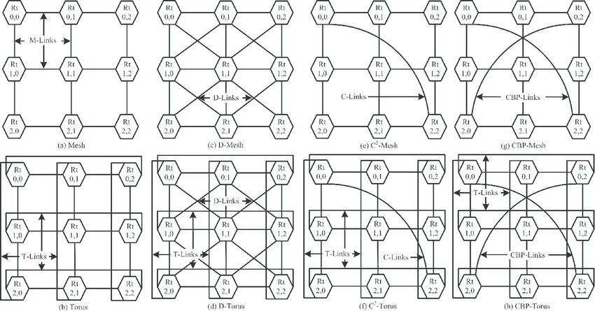
Project Milestone 2
Create a network where each team is a node inside the network.
You will need to calculate the best path between any source or destination.

Slide 3
Project Milestone 2
Example: R(2,2) to R(1,0) using XY routing method

Slide 4
Interface between FPGAs
Objectives:
Building a network using MESH topology for communication between various nodes and calculating the most efficient path.
Synchronise communication via bus broadcasts.
Each node should be connected to a VGA display and keyboard, allowing for up to 4 independent players in the racing game.
Partial reconfiguration should be employed to switch between the client and host modules, where the host has control over the game’s state (race start & end) and number of players in a race, as well as keeping track of the players’ high-scores.
At the end of each match, the winner becomes the new host via partial reconfiguration.

Slide 5
Project Milestone 2
Deliverables:
All the codes used with all the test benches, constraints and simulations
A report explaining into details all the work done + clear images for the output
A professional video showing a flow for the entire module with the output. Team members should appear and explain their contribution in the video in English.

Slide 6
Deadline for milestones 1 &2
Evaluation on 18/04/2024

Slide 7
Advanced Microelectronics Lab II
Thank you for your attention, for any inquiries contact me through E-mail
E-mail: amr.alaa@guc.edu.eg

